Slide 1

CSCI 4502/5502
Data Mining - Fall 2023 - Lecture 12
Ravi Starzl, PhD

Slide 2
1
Basic Concepts
2
Decision Tree Induction
Classification: Concepts
3
Bayesian classification
4
Rule-based classification
5
Model evaluation and selection
6
Improve classification
accuracy
Ravi Starzl, PhD - Data Mining Fall 2023
Notes:
Bayesian Classification operates on Bayes' Theorem. It determines the class label by making predictions based on probabilities, factoring in the provided predictors. At its core, Bayesian Classification measures the likelihood of a specific event happening when another event is known to have taken place.
Rule-based Classification classifies data using a series of IF-THEN rules. The 'IF' segment, termed the rule antecedent or precondition, comprises a combination of attribute tests. The 'THEN' segment, referred to as the rule consequent, designates the class label.
Model performance is assessed with a distinct test data set, not the one used for training. Metrics such as accuracy, precision, recall, F1 score, and ROC-AUC score are employed for this evaluation. The application of these metrics aids in distinguishing the optimal model among several options.
To augment the accuracy of a classifier, methods like feature selection, ensemble techniques (including bagging and boosting), cross-validation, regularization, and hyperparameter tuning can be used. Each technique has its advantages and specific scenarios of application. As an illustration, ensemble techniques utilize multiple learning models to enhance the final outcome.

Slide 3

Bayesian Classification
A statistical classifier:
predicts class membership probabilities
Foundation: based on Bayes’ Theorem
Performance (naïve Bayesian classifier)
comparable to decision tree & some neural network classifiers
Incremental
Ravi Starzl, PhD - Data Mining Fall 2023
Notes:
Bayesian Classification is a method that allows for the prediction of the likelihood that a specific data point falls into a designated class or category. For instance, in designing a system to identify spam emails, Bayesian Classification evaluates the probability of an email being classified as spam based on the frequency of certain word occurrences.
This method originates from Bayes' Theorem, a key concept in probability theory and statistics. Bayes' Theorem calculates the probability of an event by incorporating prior information regarding conditions that might be associated with the event. Within the theorem, P(A|B) denotes the probability of event A given that event B has taken place, termed 'posterior probability'. P(B|A) indicates the probability of event B occurring after event A. P(A) represents the prior probability of event A, while P(B) signifies the probability of event B.
A subset of Bayesian Classification is the Naïve Bayesian Classifier. This classifier operates under the assumption that the existence of one feature in a class is independent of any other feature's presence. Despite this assumption, Naïve Bayesian Classifiers consistently exhibit commendable results across various applications. Their effectiveness can be observed in tasks such as spam detection and sentiment analysis, where their performance can be on par with decision tree classifiers and specific neural network classifiers.
An inherent feature of Bayesian Classification is its capacity to evolve. With the introduction of new training data, the model updates the hypothesis probabilities, enabling it to remain relevant and adjust to new information. This adaptability is particularly advantageous in environments where data is continuously changing.

Slide 4
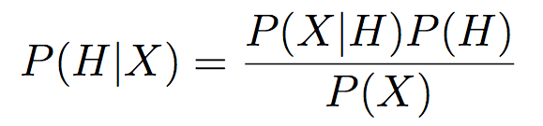
Bayes’ Theorem
X: a data sample (evidence), class unknown
e.g., X: age = 35, income = $40, 000
H: a hypothesis that X belongs to class C
e.g., H: buys a computer
Classification: determine P(H|X)
P(H), P(X): prior probability
P(X|H), P(H|X): posterior probability
Bayes’ Theorem
Ravi Starzl, PhD - Data Mining Fall 2023
Notes:
Bayes' Theorem offers a method to determine the probability of a hypothesis based on given data. Consider a data sample, X, with attributes such as age and income. For illustration, X has an age of 35 and an income of $40,000.
The hypothesis, H, proposes that X belongs to a particular class C. In this scenario, the hypothesis might suggest that an individual with these attributes is likely to buy a computer.
The goal in classification is to determine P(H|X), the probability that the hypothesis holds true given the observed data. Essentially, this evaluates the likelihood of a 35-year-old with an income of $40,000 purchasing a computer.
Bayes' Theorem is articulated as P(H|X) = (P(X|H) * P(H))/(P(X)). Each component of this equation holds significance:
- P(H) is the prior probability, signifying the initial belief about H before acquiring specific data about X.
- P(X|H), termed the likelihood, indicates the probability of observing the given data if the hypothesis is true. In this example, it evaluates the probability of encountering this age and income for a computer purchaser.
- P(X) is the evidence, which represents the overall probability of observing the data across all potential hypotheses. It serves as a standardizing factor ensuring the sum of probabilities equals one.
- P(H|X) is the posterior probability, showing the updated likelihood of the hypothesis after factoring in the observed data.
The strength of Bayes’ Theorem is its capacity to refine initial beliefs upon receiving new data. Starting with a prior belief, P(H), data is collected, the likelihood P(X|H) is calculated, and beliefs are updated to form the posterior probability, P(H|X).

Slide 5

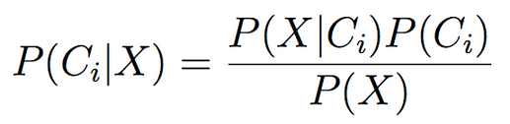
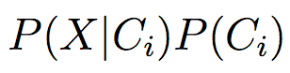
Naïve Bayesian Classifier (1)
X = (x1, x2, ..., xn) (i.e., n attributes)
m classes: C1, C2, ..., Cm
Classification: maximal P(Ci|X)
Based on Bayes’ Theorm
Since P(X) is constant for all classes, only need to maximize
Ravi Starzl, PhD - Data Mining Fall 2023
Notes:
The Naïve Bayesian Classifier is a straightforward and effective classification technique commonly employed in various fields.
Imagine a data sample, X, comprised of multiple attributes. These attributes can range from factors like age, income, and location to more specific indicators like browsing history, contingent upon the problem being tackled. This sample needs to be classified into one of several potential categories.
Within the framework of the Naïve Bayesian Classifier, the objective is to ascertain the category that is the most probable for the given data.
The foundation of this method is Bayes' Theorem, which we previously discussed. Using this theorem, the probability of a particular class given the data can be expressed in terms of three components:
1. The initial or prior belief about the likelihood of that class.
2. The likelihood of observing the given data if that class were true.
3. The overall likelihood of the data, considering all potential classes.
Note that the overall likelihood of the data remains consistent across all categories, as it isn't tied to any particular class. Thus, when determining which class is the most probable, this overall likelihood can be overlooked. The main focus is not on determining the exact probability for each class but on identifying which class offers the highest probability.

Slide 6

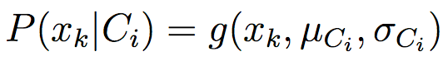
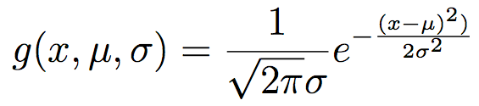
Naïve Bayesian Classifier (2)
Naïve assumption: class conditional independence (no dependence between attributes)
If Ak is categorical, P(xk|Ci)
If Ak is continuous-valued, assume Gaussian distribution
Ravi Starzl, PhD - Data Mining Fall 2023
Notes:
The Naïve Bayesian Classifier operates based on a primary assumption, commonly referred to as the 'naïve assumption'. This implies that within any given class, the attributes or features are independent of one another. In other words, the presence or absence of one attribute doesn't influence or alter the probability of another attribute, given a specific class. While this assumption might seem overly simplistic, especially when considering the intricacies of real-world data, the classifier demonstrates effective performance across various tasks.
For clarity, consider a data sample with multiple attributes. With the naïve assumption applied, the probability of the entire sample given a class can be determined by multiplying the individual probabilities of each attribute given that class. This approach simplifies the computation, as each probability can be calculated separately and then multiplied together. This is in contrast to computing the joint probability of all attributes simultaneously, which would be more intricate.
The nature of the attributes also plays a role in the classifier's computations. Attributes can either be categorical (distinct categories) or continuous (numeric values).
For categorical attributes, the probability of a specific attribute value given a class can be derived directly from training data. For instance, when classifying emails, the probability of encountering the word 'offer' in a 'spam' email can be determined by checking the fraction of 'spam' emails containing the word 'offer'.
For continuous attributes, additional assumptions about the data distribution are necessary. A prevalent assumption is the Gaussian or normal distribution. This distribution is characterized by its mean and standard deviation, which can be extracted from the training data. For instance, in a dataset analyzing credit scores, the 'income' attribute might be represented using a Gaussian distribution. The likelihood of a specific income value within this distribution can be ascertained using the Gaussian density function.
The Naïve Bayesian Classifier's efficacy primarily stems from its fundamental independence assumption. Despite being conceptually simple, the classifier is often competitive with more complex classification methods. Its straightforward nature, combined with its adaptability to various attribute types, positions it as a preferred option for numerous classification challenges.

Slide 7
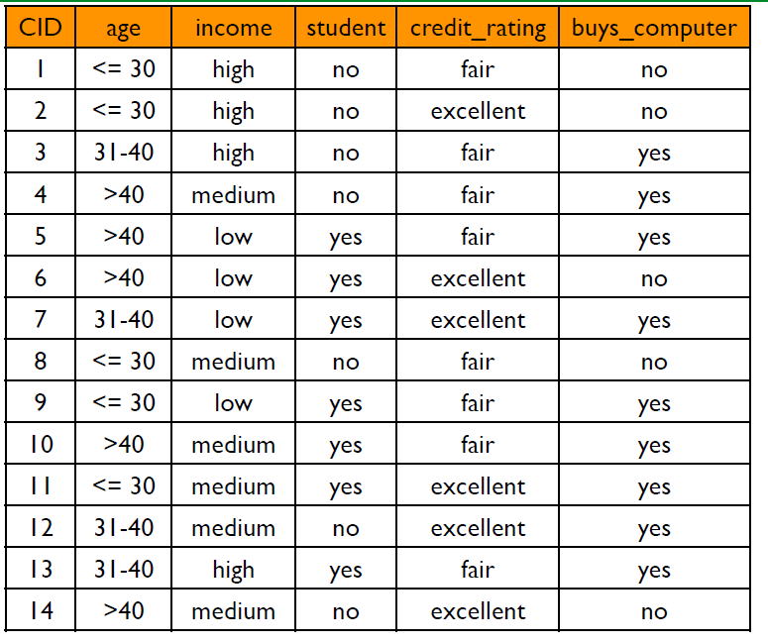
Naïve Bayesian Classifier Example
2 classes: buys_computer
C1: yes
C2: no
X = (age<=30, income=medium, student=yes, credit_rating = fair)
Ravi Starzl, PhD - Data Mining Fall 2023
Notes:
In this dataset, the decision to buy a computer is divided into two classes: "yes" (C1) and "no" (C2). The attributes under consideration are 'age', 'income', 'student status', and 'credit rating'. Given a scenario with an individual characterized as 30 years old or younger, having a medium income, being a student, and possessing a fair credit rating, this person's data can be represented as X = (age <= 30, income=medium, student=yes, credit_rating=fair).
The dataset table comprises entries from 14 individuals who previously decided to buy or not buy a computer. Each entry provides information on the individual's age, income, student status, credit rating, and their decision to buy a computer. Here, age is categorized as '30 or younger', '31-40', and 'older than 40'. Income levels are 'high', 'medium', or 'low'. Student status is either 'yes' or 'no', and credit ratings are classified as 'fair' or 'excellent'.
To determine whether person X would buy a computer using the Naïve Bayesian Classifier, follow these steps:
1. Calculate Prior Probabilities: Determine the initial probabilities P(C1) and P(C2), representing the likelihood of an individual buying or refraining from buying a computer, respectively. This is done by observing the frequencies of 'yes' and 'no' responses in the dataset.
2. Calculate Conditional Probabilities: For each attribute of person X, compute the conditional probabilities for each class. Examples include the probabilities of someone aged 30 or younger buying a computer P(age <= 30|C1), of someone with a medium income buying a computer( P(income=medium|C1)), and so on. These probabilities are derived from the respective frequencies in the dataset.
3. Apply the Naïve Bayesian Classifier: To predict the likelihood of person X buying a computer, multiply the calculated conditional probabilities with the respective prior probabilities for each class. This results in P(C1|X) and P(C2|X), which represent the probabilities of person X deciding to buy or not buy a computer.
4. Prediction: The final step is straightforward. The class (either 'yes' or 'no') with the higher probability becomes the prediction for person X. If P(C1|X) is greater than P(C2|X), it's predicted that person X will buy a computer, and vice versa.

Slide 8

Naïve Bayesian Classifier Example
buys_computer: C1 = yes, C2 = no
X = (age <= 30, income = medium, student = yes, credit_rating = fair)
P(Ci|X) = P(X|Ci) P(Ci) / P(X)
P(X|Ci) = P(age<=30 | Ci)
* P(income=medium | Ci)
* P(student=yes | Ci)
* P(credit_rating=fair | Ci)
Ravi Starzl, PhD - Data Mining Fall 2023
Notes:
Attempting to predict whether an individual will purchase a computer based on certain attributes involves evaluating the probability of them falling into one of two classes: C1 (buys a computer) or C2 (doesn't buy a computer). The individual in question, X, has been characterized by the attributes (age <= 30, income=medium, student=yes, credit_rating=fair).
To determine the likelihood of X belonging to a specific class Ci, the Naïve Bayesian Classifier employs Bayes' theorem, which provides the following relationship: the probability of class Ci given the attributes of X is proportional to the likelihood of X having those attributes if they were in class Ci, multiplied by the prior probability of class Ci.
In this relationship:
- P(X|Ci) signifies the likelihood of the individual possessing the stated attributes if they were part of class Ci.
- P(Ci) denotes the prior probability of class Ci, which is the initial belief about the likelihood of the class before considering X's attributes.
- P(X) is the overall likelihood of the attributes, serving to normalize the probabilities so they sum to one.
A central component here is P(X|Ci), which is computed by multiplying the conditional probabilities of each attribute given a class. The "naïve" assumption of the Naïve Bayesian Classifier assumes that each attribute's presence is independent of the other attributes when considering a specific class. This independence leads to the simplification where the joint probability is obtained by multiplying the individual attribute probabilities.
To illustrate, for our example, the probability P(X|Ci) is the product of the probabilities of each of the attributes given class Ci. These probabilities are derived from the training data. For example, to determine the probability that someone aged 30 or younger belongs to class Ci, the number of instances in Ci with 'age <= 30' is divided by the total instances in that class.
The prior class probability, P(Ci), is ascertained by the proportion of data entries that fall into class Ci. For instance, P(C1) is determined by the frequency of 'yes' responses in the dataset relative to the dataset's total size.
After computing the probabilities P(C1|X) and P(C2|X), the class with the greater probability is selected as the prediction for X. For instance, if P(C1|X) exceeds P(C2|X), it's predicted that X will purchase a computer, and if not, the opposite is predicted.

Slide 9
Naïve Bayesian Classifier Example
P(buys_computer = “yes”) = 9/14 = 0.643
P(buys_computer = “no”) = 5/14= 0.357
P(age = “<=30” | buys_computer = “yes”) = 2/9 = 0.222
P(age = “<= 30” | buys_computer = “no”) = 3/5 = 0.6
P(income = “medium” | buys_computer = “yes”) = 4/9 = 0.444
P(income = “medium” | buys_computer = “no”) = 2/5 = 0.4
P(student = “yes” | buys_computer = “yes) = 6/9 = 0.667
P(student = “yes” | buys_computer = “no”) = 1/5 = 0.2
P(credit_rating = “fair” | buys_computer = “yes”) = 6/9 = 0.667
P(credit_rating = “fair” | buys_computer = “no”) = 2/5 = 0.4
P(X|buys_computer = “yes”) = 0.222 x 0.444 x 0.667 x 0.667 = 0.044
P(X|buys_computer = “no”) = 0.6 x 0.4 x 0.2 x 0.4 = 0.019
P(X|buys_computer = “yes”) * P(buys_computer = “yes”) = 0.028
P(X|buys_computer = “no”) * P(buys_computer = “no”) = 0.007
Ravi Starzl, PhD - Data Mining Fall 2023
Notes:
Using the Naïve Bayesian Classifier, we can evaluate the likelihood of an event based on prior knowledge combined with new evidence. Let's revisit the case of person X, characterized by attributes (age≤30, income=medium, student=yes, credit_rating=fair), to determine whether they would purchase a computer.
1. Prior Probabilities:
- The probability of someone buying a computer, denoted by P(buys_computer = “yes”), is 0.643. This is deduced from the dataset where 9 out of 14 individuals bought a computer.
- Conversely, the probability of someone not buying a computer, P(buys_computer = “no”), is 0.357. In our dataset, 5 out of 14 individuals decided against the purchase.
2. Conditional Probabilities:
- Using the dataset, the likelihood of an individual aged 30 or less buying a computer is P(age = “<=30” | buys_computer = “yes”) which equals 0.222. This is based on 2 out of 9 computer buyers being 30 or younger.
- Similar calculations are performed for other attributes to determine their respective probabilities given the class.
3. Computing Probabilities for Person X:
- By leveraging the Naïve Bayes assumption of conditional independence among attributes, the probability of person X's attributes given they bought a computer is obtained by multiplying the individual conditional probabilities. This results in a likelihood of 0.044 for person X's attributes among those who purchased computers.
4. Updating Using Prior Probabilities:
- The prior probabilities are combined with the computed probabilities to update the likelihoods. By multiplying 0.044 with 0.643, a value of 0.028 is obtained for the likelihood that person X would buy a computer. Similarly, the likelihood of person X not buying a computer is computed to be 0.007.
5. Making the Prediction:
- The decision is based on comparing the two computed values, 0.028 and 0.007. Since 0.028 is greater, the prediction is that person X will buy a computer.
The underlying principle of this process is to use past data to form expectations about future events. By integrating our initial beliefs with new evidence, we refine these beliefs to make informed predictions.

Slide 10
Avoid 0-Probability
The 0-probability problem
e.g., income: low(0), medium(990), high(10)
Laplacian correction (or Laplace estimator)
add 1 to each case: non-zero, close to original probabilities
e.g., income: low(1), medium(991), high(11)
Ravi Starzl, PhD - Data Mining Fall 2023
Notes:
When utilizing the Naïve Bayesian Classifier on datasets, there is a potential pitfall known as the '0-probability problem'. This issue arises when a category within the dataset has a frequency of zero. Due to the multiplicative nature of the Naïve Bayesian Classifier, a zero frequency for any category results in a final computed probability of zero for the entire data point, skewing the results.
For instance, consider a dataset analyzing income levels. While 'medium' and 'high' incomes have been observed, there's an absence of 'low income' entries. Despite the likelihood of encountering 'low income' individuals in the real world, the dataset doesn't capture this. If left unaddressed, the model would always assign a zero probability to any instance with a 'low income' attribute, leading to potentially incorrect classifications.
To address this issue, the 'Laplacian correction' or 'Laplace estimator' is employed. This method involves adding a value (typically 1) to each frequency, ensuring no category has a zero probability. In our income example, the corrected frequencies would be 'low(1)', 'medium(991)', and 'high(11)'. This adjustment ensures the model remains informative and avoids the pitfalls of extreme zero predictions.
To illustrate further, consider the computation of P(X|Ci), the probability of an instance X given a class Ci. This is the product of individual probabilities for each feature of X given Ci. Without the Laplacian correction, a zero frequency for any feature in class Ci would result in the entire P(X|Ci) becoming zero. Such an outcome could cause the model to completely disregard class Ci for any new instance with that particular feature, even if other features might suggest Ci as a potential class.
By employing the Laplacian correction, every probability remains non-zero, preserving the potential for class Ci to be considered for new instances, even if some features have not been observed in the training data for that class.

Slide 11

Naïve Bayesian Classifier
Advantage
easy to compute, good results in most cases
Disadvantage
assumption: class conditional independence
dependencies exist in practice
e.g., hospital patients: age, family history, fever, cough, lunch cancer, diabetes, etc.
Ravi Starzl, PhD - Data Mining Fall 2023
Notes:
The Naïve Bayesian Classifier is a widely used statistical classification method. Its name "naïve" stems from its foundational assumption regarding the data: it presumes class conditional independence. This implies that within the dataset, all features are considered independent of each other when factoring in the class.
Advantages:
1. Computational Simplicity: The method is computationally straightforward. It involves calculating probabilities for each attribute against each class, and then multiplying these probabilities to deduce the likelihood of a particular result. This efficiency is particularly beneficial for sizable datasets.
2. Effective Performance: Despite its simplicity and the potential inaccuracy of its independence assumption, the classifier often yields commendable results. It has exhibited high accuracy in applications like text classification and spam detection.
Limitations:
1. Independence Assumption: The primary limitation of this classifier is its inherent assumption of class conditional independence. Real-world data often exhibits interdependencies between features. By overlooking these interdependencies, the model may become oversimplified or less accurate.
- For example, in a dataset containing patient details, attributes like age, family history, and symptoms can be interconnected. The Naïve Bayesian Classifier would compute the probabilities for these attributes independently, potentially failing to capture the intricacies of the dataset.
Naïve Bayesian Classifier is frequently employed as an initial model in various classification tasks. Its simplicity and computational benefits make it an attractive option. Moreover, there are advanced versions of this classifier, like the Tree Augmented Naïve Bayes classifier, designed to encapsulate some dependencies among features.

Slide 12
1
Basic Concepts
2
Decision Tree Induction
Classification: Concepts
3
Bayesian classification
4
Rule-based classification
5
Model evaluation and selection
6
Improve classification
accuracy
Ravi Starzl, PhD - Data Mining Fall 2023
Notes:
Rule-based classification is a method wherein data is classified using a series of rules. These rules can be visualized as sequential instructions or guidelines that lead to decision-making. Each rule is constructed using an "if-then" format.
Components:
1. Rule Antecedent (Precondition): The 'if' part of the rule, which describes specific criteria or conditions.
2. Rule Consequent (Postcondition): The 'then' part of the rule, which states the outcome or decision resulting from the antecedent conditions.
Example:
A real-world analogy is the rule: "If it rains, then take an umbrella." Here, "It rains" is the antecedent, and "Take an umbrella" is the consequent. Translating this into a data classification context, a rule could be: "If age is less than 30 and owns a sports car, then high insurance risk." In this scenario, the antecedent comprises the attributes (age and car type), and the consequent provides the classification (insurance risk level).
Advantages:
1. Intuitiveness and Interpretability: Rule-based classifiers are easily understood, making them valuable in contexts where clear explanations are required.
2. Expressiveness: These classifiers can potentially capture more intricate decision boundaries compared to decision trees, though this might come at the expense of a more complex rule set.
Rule Learning:
The process of deriving these rules from data can be achieved through various methods. A common approach is the "separate-and-conquer" or "divide and conquer" technique. This method entails deriving rules for individual classes by distinguishing them from the rest of the data and identifying the most salient attributes.
Perspective:
While rule-based classification offers several benefits, it's essential to understand that it's just one of many classification techniques. The optimal classification approach largely depends on the dataset and the specific problem being addressed. However, for those interested in a human-readable and intuitive method, rule-based classification provides a compelling avenue to explore.

Slide 13

IF-THEN Rules
IF condition THEN conclusion
R: IF age = youth AND student = yes THEN buys_computer = yes
rule antecedent/precondition (IF) rule consequent (THEN)
Assessment of a rule
coverage(R) = ncovers / |D|
accuracy(R) = ncorrect / ncovers
Ravi Starzl, PhD - Data Mining Fall 2023
Notes:
Rule-based classification revolves around the core concept of IF-THEN rules. Each rule offers a structured decision-making path, guiding the classification process.
Consider the example rule, \( R \): IF age is young AND student status is yes, THEN the decision is that the individual will buy a computer.
**Components**:
1. **Antecedent (Precondition)**: This is the 'IF' part. In our example, "age is young and student status is yes" serves as the precondition.
2. **Consequent (Postcondition)**: This is the 'THEN' outcome. For the given example, the outcome is that the individual will buy a computer.
This structure is designed for simplicity and clarity, enabling ease of interpretation. However, to ensure that these rules are beneficial, we need metrics to evaluate their quality: coverage and accuracy.
**Coverage**:
Coverage, represented as \( \text{coverage}(R) \), quantifies the rule's applicability across the dataset. It's the fraction of the dataset where the rule is relevant.
\[
\text{coverage}(R) = \frac{\text{number of instances where rule applies}}{\text{total number of instances in the dataset}}
\]
For example, if there are 100 people in the dataset and the rule applies to 30, the coverage is \( \frac{30}{100} = 0.3 \).
**Accuracy**:
Accuracy, denoted as \( \text{accuracy}(R) \), measures the correctness of the rule when it is applied.
\[
\text{accuracy}(R) = \frac{\text{number of instances correctly classified by the rule}}{\text{number of instances where rule applies}}
\]
Using the previous example, if the rule correctly classifies 25 out of the 30 applicable instances, the accuracy is \( \frac{25}{30} \approx 0.83 \).
Both metrics are essential for understanding a rule's utility:
- Coverage offers insights on the rule's relevance or applicability in the dataset.
- Accuracy indicates the rule's reliability when it is relevant.

Slide 14
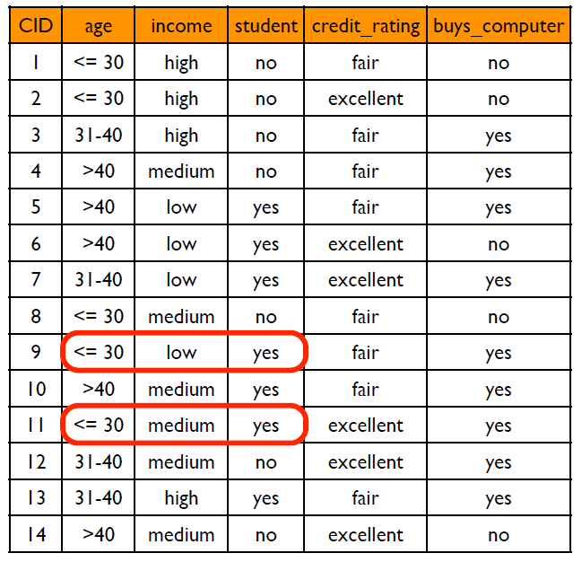
Rule Assessment Example
R: IF age <= 30 AND student = yes THEN buys_computer = yes
coverage (R) = ncovers / |D|
accuracy (R) = ncorrect / ncovers = 2/2
Ravi Starzl, PhD - Data Mining Fall 2023
Notes:
Rule-based classification is centered around the use of IF-THEN rules. Each rule offers a clear decision-making path. Let's understand the assessment of our example rule, ( R).
The rule (R) states: IF an individual is 30 years old or younger AND is a student, THEN we predict that this person will buy a computer.
Breaking down this rule:
1. The Condition: "Age is 30 or younger and the individual is a student" - This sets the criteria that needs to be met.
2. The Outcome: "The person will buy a computer" - This is the prediction if the criteria is true.
Given our dataset of 100 people, our aim is to identify young students (those 30 or under) who might purchase a computer.
From the dataset, let's assume 20 individuals fit the age and student status criteria set by our rule. This means the rule is relevant or applies to these 20 individuals. Therefore, the rule covers 20% of the entire dataset.
Next, let's talk about how accurate the rule is. Among the 20 young students, if all of them actually purchased a computer, then our rule has been 100% accurate for the cases it covers.
To summarize:
The rule (R) provides insights:
- It's relevant to 20% of our dataset.
- For the cases it covers, it's making correct predictions 100% of the time.
While the rule (R) is very accurate, it's important to note that it's relevant for only a fifth of the dataset. The balance between how much of the dataset a rule covers and how accurate it is, is crucial. Ideally, a rule should be relevant to a large portion of the dataset and also make correct predictions most of the time.

Slide 15
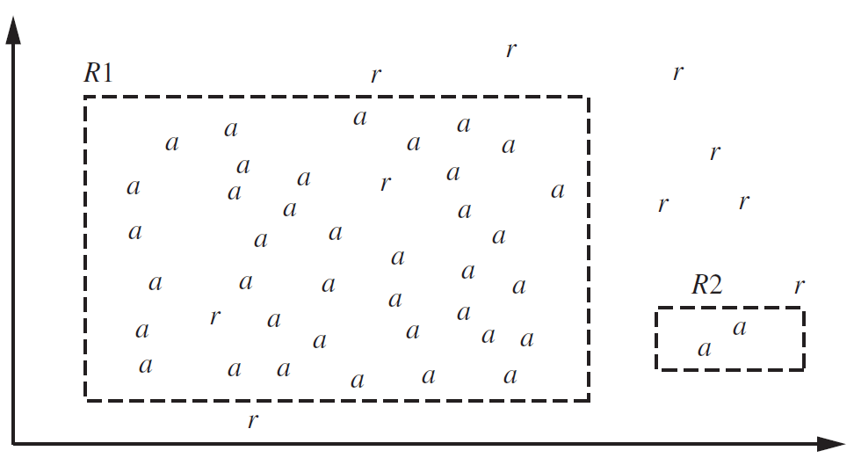
Rule Quality Measures
Coverage?
Accuracy?
Ravi Starzl, PhD - Data Mining Fall 2023
Notes:
In rule-based classification, decisions are made based on predefined rules. Consider the example of predicting computer purchases based on age and income. In a graph plotting age against income, two regions, R1 and R2, can be demarcated based on a rule postulating that younger individuals with higher incomes have a higher propensity to purchase a computer.
The term "coverage" denotes the quantity of individuals encompassed within the regions R1 and R2. Expansive regions imply that a larger population is captured by the rule. However, overextending the boundaries of R1 and R2 might inadvertently encompass individuals not aligned with the rule's premise.
"Accuracy" quantifies the proportion of individuals within R1 and R2 who conformed to the prediction, i.e., made a computer purchase. Maximum adherence within R1 and R2 to the purchasing prediction signifies optimal accuracy. Conversely, minimal adherence indicates a rule with extensive coverage but diminished accuracy.
For instance, if R1 has a vast span and includes numerous individuals, but only a fraction make a purchase, then R1 possesses extensive coverage yet diminished accuracy. In contrast, if R2, though smaller, contains a populace where the majority purchased a computer, it is characterized by limited coverage but heightened accuracy.
It is pivotal to acknowledge potential complexities in the association between age, income, and the propensity to purchase a computer, manifesting as non-linearity in the data.
While rule-based classification offers adaptability to intricate data structures, it is susceptible to overfitting. Overfitting arises when a model excessively aligns with the idiosyncrasies of a specific dataset, compromising its efficacy on novel data.

Slide 16

Rule-Based Classification
Rule R is triggered (precondition satisfied)
R is the only rule triggered
No rule is triggered
More than one rules are triggered
size ordering: most attribute tests
class-based ordering: importance (e.g., prevalence, misclassification cost)
rule-based ordering: (decision list) priority list ordered by rule quality or by experts
Ravi Starzl, PhD - Data Mining Fall 2023
Notes:
rule-based classification, at its core, works by examining data instances against a set of predefined rules. Here's a breakdown of the scenarios you might encounter:
1. Rule is Triggered: This is the straightforward case where the conditions of a rule match a data instance. Using our example, if someone is under 35 and earns more than 40,000, our rule predicting they'll buy a computer is activated.
2. Only One Rule is Triggered: This makes classification simple. For the dataset in question, if our rule about age and income is the only one that gets activated, we just apply the outcome of that rule.
3. No Rule is Triggered: This is a problematic scenario. If none of our rules apply to a data instance, we're in the dark about its classification. We might need to rely on backup strategies, such as:
- Assigning the most common class.
- Using another classification method.
4. Multiple Rules are Triggered: This is where complexity increases. If more than one rule applies to a data instance, we need a system to decide which rule to follow. Here are some methods:
- Size Ordering: This prioritizes more detailed rules. For instance, a rule that checks age, income, and job might be ranked higher than one that only considers age and income.
- Class-based Ordering: Here, the importance of the predicted class guides the choice of rule. For example, in medical datasets, a rule diagnosing a critical disease might be prioritized.
- Rule Quality Ordering: Some rules are more reliable than others. This method ranks rules based on their past performance or accuracy.
- Expert Ordering: In some cases, domain experts might rank rules based on their knowledge.

Slide 17
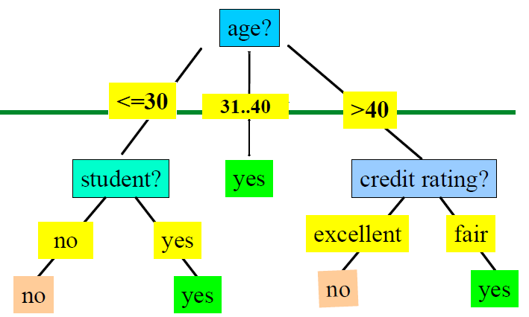
Rule Extraction
From a decision tree
Each root to leaf path
Leaf: class prediction
Rules are exhaustive and mutually exclusive
IF age=31...40 THEN buys_computer=yes
IF age<=30 AND student=no THEN buys_computer=no
IF age>40 AND credit_rating=fair THEN buys_computer = yes
Ravi Starzl, PhD - Data Mining Fall 2023
Notes:
rule extraction from decision trees is a way of translating the intricate structure of a tree into a set of clear and actionable rules. Here's a breakdown:
1. Basic Concept: A decision tree is essentially a series of decisions made based on attribute values of data. Every path from the root of the tree to a leaf can be translated into an IF-THEN rule. The conditions or decisions you encounter along the path form the 'IF' part, and the class label at the leaf node becomes the 'THEN' part.
2. Rule Extraction: To extract a rule from a decision tree, you trace a path from the root to a leaf. Each decision or branch point along this path is a condition. By chaining these conditions together using "AND", you create the antecedent or the 'IF' part of the rule. The leaf node provides the consequent or the 'THEN' part.
For instance, if in our decision tree, a path indicates decisions "age=31 to 40" and ends in a leaf "buys_computer=yes", the rule becomes: "IF age=31 to 40, THEN buys_computer=yes."
3. Exhaustive and Exclusive Rules:
- Exhaustive: The rules you extract from a decision tree cover all scenarios present in your training data. This is because a decision tree is constructed to classify every instance in the dataset, ensuring that there's a rule for each situation.
-Mutually Exclusive: Since each data instance traverses down one and only one path in the tree, it will only satisfy one rule. This ensures that the rules you extract don't contradict one another.
4. Advantages:
- Interpretability: Rules are simple to understand. They provide a direct and intuitive way of understanding the patterns learned by the decision tree.
- Communication: Clear rules can be easily shared with stakeholders, even those without a technical background, making it easier to communicate insights and results.
- Actionable Insights: Rules often provide actionable recommendations, such as "IF these conditions are met, THEN take this action."
5. Beyond Decision Trees: While we've focused on decision trees, many other models can also be translated into rules. Methods exist to extract rules from neural networks, support vector machines, and other classifiers. These can be more complex but aim to provide the same clarity and understanding that decision tree-based rules offer.

Slide 18
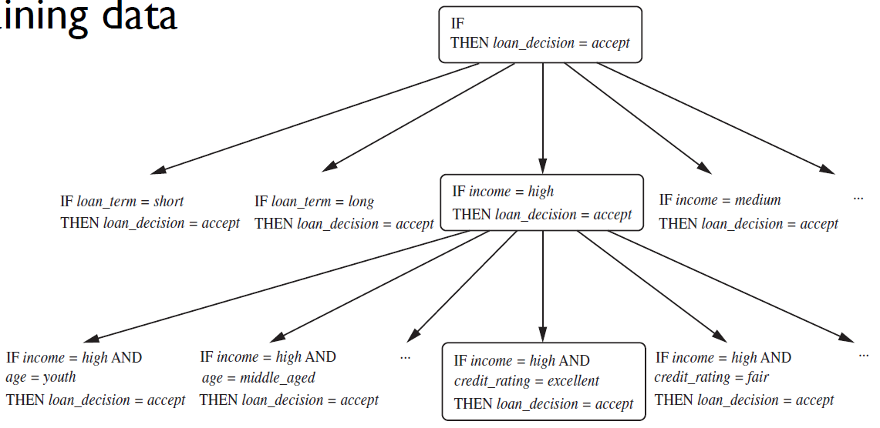
Example
Greedy depth-first strategy: Learn directly from training data
Ravi Starzl, PhD - Data Mining Fall 2023
Notes:
Rule-based systems, especially ones that use "IF-THEN" rules, are popular because of their transparency and interpretability. Let's break down their use in the context of a bank's loan decision-making process:
1. Simple & Clear Decision Paths: The "IF-THEN" rules provide straightforward decision criteria. In our loan-decision problem, factors like employment status, credit history, and income become the conditions or checks (the "IF" part) that lead to a particular decision, the "THEN" part. Each rule offers a clear path to making a decision.
2. Reflecting Business Logic: These rules often mirror the bank's actual criteria for loan approval. For instance, permanent employment and a good credit history are typically seen as positive indicators of a person's ability to repay a loan. Therefore, the rule "IF employment_status=permanent AND credit_history=good THEN loan_decision=yes" makes logical sense.
3. Handling Multiple Scenarios: Different combinations of conditions can lead to different decisions. For instance, a temporary worker with a high income and good credit history might still be considered for a loan, as indicated by the nested rule. This flexibility allows the bank to cater to various customer profiles and scenarios.
4. Transparency and Trust: The explicit nature of "IF-THEN" rules makes the decision-making process transparent. When a loan application is approved or rejected, the bank can point to a specific rule (or set of rules) that led to that decision. This transparency can build trust with customers, especially if they seek an explanation for a decision.
5. Modifiability: One of the significant advantages of using "IF-THEN" rules is that they can be easily modified. If a bank wants to change its criteria or introduce new ones, they can adjust, add, or remove rules without overhauling the entire system.
6. Efficiency in Real-time Decisions: Given their clear structure, "IF-THEN" rules can be rapidly executed, making them suitable for applications that require real-time decisions, such as online loan approval systems.

Slide 19
1
Basic Concepts
2
Decision Tree Induction
Classification: Concepts
3
Bayesian classification
4
Rule-based classification
5
Model evaluation and selection
6
Improve classification
accuracy
Ravi Starzl, PhD - Data Mining Fall 2023
Notes:
Model Evaluation: This is the process of determining how well our trained model will perform on unseen data. Here's a brief overview:
1. Train/Test Split: The dataset is divided into a training set, which is used to train the model, and a testing set, which is used to evaluate the model's performance. This helps ensure that our model's performance is evaluated on data it hasn't seen before, providing a more realistic estimate of its performance in real-world scenarios.
2. Metrics: We use various metrics to gauge the model's performance. These might include accuracy, precision, recall, F1-score, ROC curves, and AUC, among others. Each metric provides a different perspective on the model's capabilities.
3. Overfitting and Underfitting: During evaluation, we're also on the lookout for signs of overfitting (where the model performs exceptionally well on the training data but poorly on the testing data) and underfitting (where the model performs poorly on both sets). A good model strikes a balance, generalizing well to new data.
Model Selection: Here, we're choosing the best model from several contenders. This involves:
1. Cross-Validation: This technique involves partitioning the dataset into multiple subsets. The model is trained on some of these subsets and tested on others. This is repeated multiple times, rotating the training and testing sets. It provides a more stable estimate of model performance.
2. Comparing Models: We might train multiple models using different algorithms or different parameter settings for the same algorithm. By comparing their performance using our evaluation metrics, we can select the one that's best suited to our needs.
3. Domain Knowledge: Sometimes, the best model isn't just about the numbers. Domain knowledge and understanding of the application area can guide model selection. For instance, in critical applications like medical diagnosis, we might prioritize recall (catching all positive cases) over precision (being right when we predict a positive).
4. Complexity and Interpretability: Simpler models are often preferred because they are easier to understand and explain. For instance, a decision tree might be preferred over a complex neural network in situations where interpretability is crucial.

Slide 20
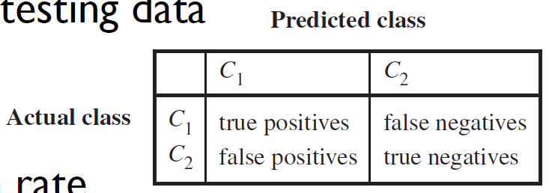
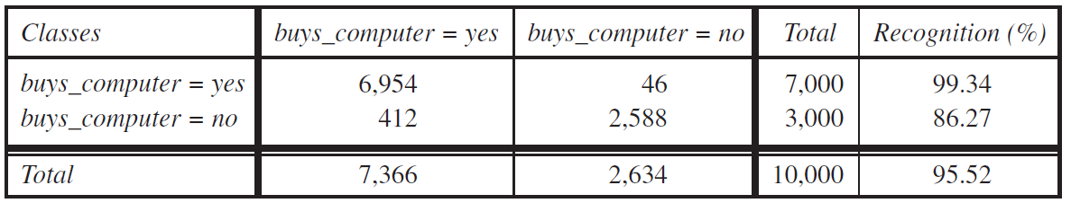
Classifier Accuracy Measures
Partition: training data and testing data
Accuracy, recognition rate
Error rate, misclassification rate
Confusion matrix
Ravi Starzl, PhD - Data Mining Fall 2023
Notes:
Partitioning data into training and testing sets is essential for an unbiased performance estimate. This ensures the model is evaluated on unseen data, similar to being tested on different questions after studying a topic.
Accuracy shows how often the model predicts correctly overall. But it doesn't detail how it performs on individual classes. The recognition rate does, indicating performance for each class. A model might predict one class well, but not another. If a class dominates the dataset, accuracy might be misleadingly high.
The confusion matrix provides a detailed breakdown. It indicates both correct predictions and errors. Diagonal cells show correct predictions, while off-diagonal ones show mistakes. For instance, an off-diagonal cell at 'yes' and 'no' shows times the model predicted 'no' instead of 'yes'.
Rates, like the recognition rate, stem from the confusion matrix, highlighting the model's strengths and areas for improvement. Using these insights can guide refining strategies, like gathering more data or trying a different algorithm, aiming to boost performance for each class.

Slide 21

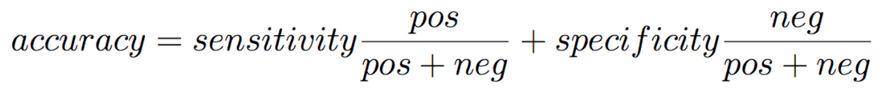
Classifier Accuracy Measures
Sensitivity: t_pos / pos
Specificity: t_neg / neg
Precision: t_pos / (t_pos + f_pos)
Costs and benefits of TP, TN, FP, FN
Ravi Starzl, PhD - Data Mining Fall 2023
Notes:
Sensitivity: This metric, also known as the true positive rate, measures how well our classifier correctly identifies positive cases. Think of it as the model's ability to catch all the relevant instances. For a medical test, sensitivity would tell us how many patients with the disease were correctly identified by the test.
Specificity: Specificity assesses how well the classifier identifies negative cases. In other words, it gauges the model's ability to correctly ignore irrelevant instances. If we're talking about a medical test, specificity helps us understand how well the test recognizes patients without the disease, ensuring we don't mistakenly label healthy individuals as sick.
Precision: Precision focuses on the positive predictions our classifier makes and asks, "Of all the positive predictions, how many were actually correct?" In our medical test analogy, if our test indicates ten patients have a disease, but only seven truly do, then our precision tells us that 70% of our positive predictions were accurate.
Accuracy: Accuracy gives a broad snapshot of how well the classifier performs across all instances. It's an average measure of correct predictions but can be a bit deceiving if our data is imbalanced (where one class significantly outnumbers the other).
Alongside these metrics, we also consider the outcomes of our classifications:
- True Positives and True Negatives are instances where our classifier's predictions were correct.
- False Positives are when our classifier mistakenly predicts a positive outcome.
- False Negatives are when our classifier fails to identify a positive outcome.

Slide 22
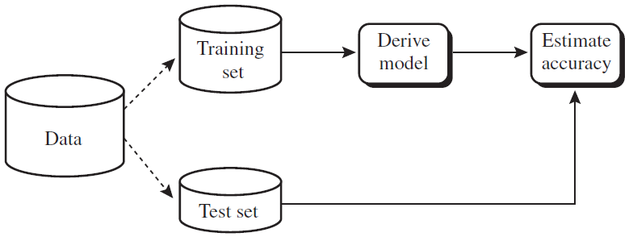
Holdout, random sampling
Cross-validation
divide into k subsamples
use k-1 subsamples for training, one for testing --- k-fold cross validation
Bootstrapping (e.g., .632 bootstrapping)
sample with replacement => training data
Classifier / Predictor Evaluation
Ravi Starzl, PhD - Data Mining Fall 2023
Notes:
Holdout Method:
In the holdout method, the dataset is split into two parts: training and testing. The model learns from the training data and is assessed using the testing data. While this method is straightforward, its performance estimation can vary based on how the data is split. For instance, if crucial data points end up in the testing set and aren't used for training, the model might not perform optimally.
Random Sampling:
To address the holdout method's variability, random sampling creates multiple random splits of the data into training and testing sets. We then average the results from these splits. This approach provides a more consistent performance estimation since it reduces the reliance on a single data split.
Cross-validation:
Cross-validation improves upon the holdout method by repeatedly splitting the data. In k-fold cross-validation, the data is divided into 'k' subsets. The model is trained on 'k-1' of these subsets and tested on the remaining one. This process rotates until each subset has been used for testing. Cross-validation ensures every data point gets tested, leading to a comprehensive performance assessment.
Bootstrapping:
Bootstrapping involves sampling the original dataset with replacement to create new datasets. One popular approach, the .632 bootstrapping, trains on a bootstrap sample and tests on the data points not included in this sample. Bootstrapping is especially helpful with smaller datasets, as it effectively increases the data size through resampling.
Understanding Training and Testing Data Split:
The concept of splitting data into training and testing subsets is to prevent overfitting. Overfitting occurs when a model is too tailored to its training data and fails to generalize well to new data. By setting aside a test set, we can evaluate how well the model performs on data it hasn't seen during training.
An analogy to understand this is thinking of students preparing for an exam. If students only memorize answers to specific questions, they'll struggle when faced with slightly different questions on the actual exam. Similarly, a model trained too closely on its training data might not perform well on slightly different data in the test set.

Slide 23
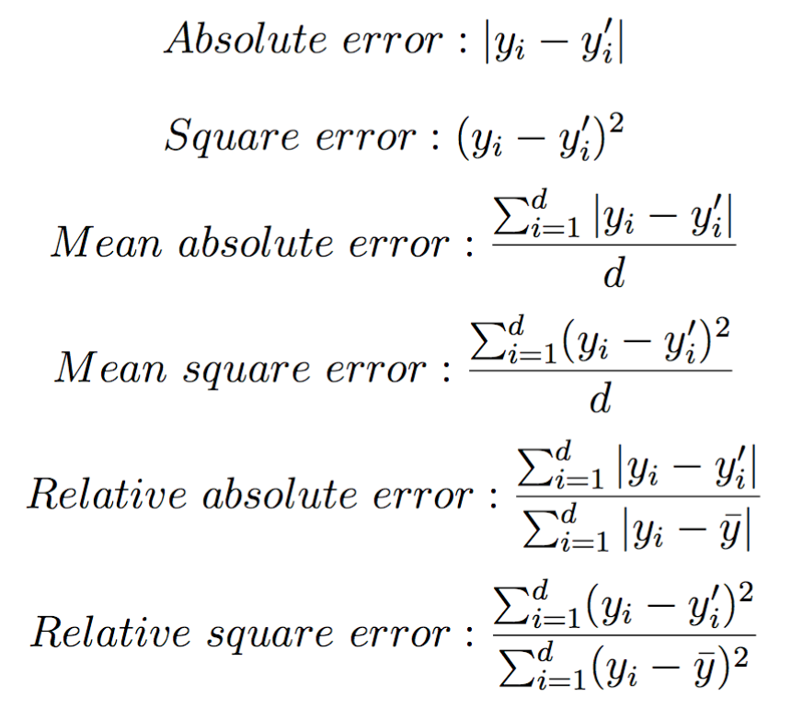
Predictor Error Measures
Ravi Starzl, PhD - Data Mining Fall 2023
Notes:
1. Absolute Error:
This error metric tells us the straightforward difference between what our model predicted and what the actual value was. Think of it as how far off our single prediction was.
2. Square Error:
Here, instead of looking at the raw difference, we consider its square. This has the effect of emphasizing larger errors. So, if our prediction is way off, this metric will make it stand out more than the absolute error would.
3. Mean Absolute Error:
Imagine taking all the individual absolute errors from our predictions and averaging them out. This gives us an idea of the "typical" error our model makes on average.
4. Mean Square Error:
Again, instead of the raw differences, we're looking at their squares. But this time, we average those squared differences across all predictions. This metric can give a clearer picture when larger errors are especially problematic.
5. Relative Absolute Error:
This is about putting the absolute error into perspective. Instead of just saying our prediction was off by a certain amount, we express that error as a fraction of the actual value. This can be helpful to understand how significant an error is in context.
6. Relative Square Error:
Similarly, this metric provides a sense of the squared error relative to the actual value squared. It helps understand the significance of our squared error in the context of the data.

Slide 24

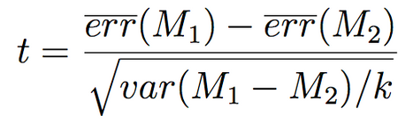
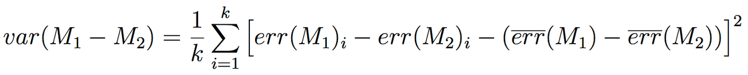
Model Selection
Choose between two models M1 and M2
Mean error rate? (k-fold cross validation)
estimated error on future data
Difference between error rates of M1 & M2
statistically significant? or by chance?
t-test
Ravi Starzl, PhD - Data Mining Fall 2023
Notes:
When comparing two models, differentiate genuine performance differences from those that may arise from random variations or chance. To illustrate:
Consider two students, A and B, taking a series of math tests to determine their proficiency. If A scores higher in one test, it doesn't conclusively indicate A's superiority. But if A consistently outscores B across multiple tests, there's a growing belief in a real difference in ability.
In the same vein, when comparing models M1 and M2, a slight performance advantage for one on a specific dataset doesn't immediately denote its superiority. It's essential to ascertain that this performance isn't an anomaly or influenced by random factors in the dataset.
This is where statistical tests, like the t-test, become valuable. These tests help determine if observed performance differences are statistically significant, implying that they are more likely due to the models' inherent properties than mere chance.
The t-test examines the average performance difference between the two models against the variations in their performances. If the disparity is substantial relative to the variations, the t-test indicates a probable genuine difference.
Conducting a one-tailed t-test means checking if one model outperforms the other, analogous to asking, "Is A more proficient than B?" Conversely, a two-tailed test is broader, assessing if there's a significant difference in their capabilities without pinpointing a superior model. This is akin to inquiring, "Do A and B differ in their math skills?"

Slide 25
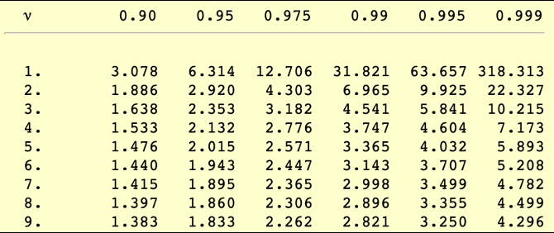
T-test Example
10-fold cross-validation: 10 pairs of error values
T-table (e.g., https://www.itl.nist.gov/div898/handbook/eda/section3/eda3672.htm)
Degree of freedom: v = 10-1 = 9
Significance level: a = 0.05
Two-sided test: 1-a/2 = 1-0.05/2 = 0.975
Check T-table (v=9, 0.975): critical value is 2.262
Compute t, statistically significant if t > 2.262
Ravi Starzl, PhD - Data Mining Fall 2023
Notes:
Scenario:
Imagine you're tasked with predicting house prices, and you've built two models: a Linear Regression model (Model A) and a Decision Tree model (Model B). You want to know which model predicts more accurately.
Step-by-Step Process:
1. Data Split & Model Training:
You split your dataset into 10 equal parts for a 10-fold cross-validation. You train both models using 9 parts and test on the 1 part left out. You repeat this 10 times, changing the test part each time. As a result, you get 10 error values for both models.
2. Objective:
You want to see if the difference in their average errors is just by chance or if one genuinely performs better.
3. Null Hypothesis (H0):
Model A and Model B have the same average error. Any observed difference is due to randomness in the data.
4. Alternative Hypothesis (H1):
Model A and Model B have different average errors. The difference is not just due to randomness.
5. Using the t-test:
You compute the t-value based on the differences in the errors from the 10 folds. This value will tell you how far apart the errors from your models are compared to how spread out they are.
6. Checking Against Critical Value:
You refer to a t-distribution table. With 9 degrees of freedom (10-1) and a 95% confidence level (α = 0.05), you find a critical value, say 2.262.
7. Decision Making:
If the absolute t-value you computed is greater than 2.262, you reject the null hypothesis. This means the difference in performance is statistically significant, and one model is better. If not, you can't confidently say one model is better based on the data you have.
8. Interpretation:
Let's say your t-value was 2.8. Since 2.8 > 2.262, you conclude that there's a statistically significant difference in the performance of the two models.
Visualization:
In the hypothetical figure, there'd be two columns showing error values from each fold for both models. At the bottom, you'd see the calculated t-value (e.g., 2.8) and a note indicating the critical value (2.262). A visual comparison would easily show the t-value surpassing the critical threshold, signaling a significant difference.

Slide 26
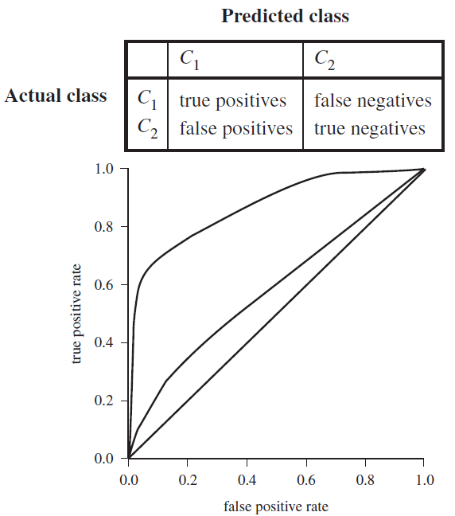
Model Selection:
ROC Curves
Visual comparison of models
X: false positive rate
f_pos / neg
Y: true positive rate
t_pos / pos
Area below curve:
accuracy, diagonal line: 0.5 accuracy
Ravi Starzl, PhD - Data Mining Fall 2023
Notes:
1. ROC Curve Basics:
- X-axis (False Positive Rate): Think of this as the percentage of non-spam emails that we wrongly marked as spam.
- Y-axis (True Positive Rate): This is the percentage of actual spam emails we correctly identified as spam.
2. Thresholds:
Every point on the ROC curve corresponds to a different decision threshold. A decision threshold is like a boundary value. If the probability of being spam is above this value, we label the email as spam. As we change this threshold, both our false positive rate and true positive rate change, giving us a new point on the ROC curve.
3. AUC - Area Under the Curve:
This is like a summary statistic of the ROC curve. The AUC gives a single number summarizing the overall performance of a classifier. The closer the AUC is to 1, the better. A perfect classifier has an AUC of 1, while one that's no better than random guessing has an AUC of 0.5.
4. Illustration with the Confusion Matrix:
- Confusion Matrix: This is a grid that shows the actual versus predicted classifications. The matrix will have values for true positives, true negatives, false positives, and false negatives.
- Connection with ROC: For every decision threshold, we get a different confusion matrix. By plotting the resulting true positive rate and false positive rate values from these matrices, we build our ROC curve.
5. Interpreting with a Real-World Example:
- Email Spam Filters (M1 vs. M2): Let's say M1 has a curve that hugs the top left corner of the plot, while M2's curve is closer to the diagonal (chance) line. Even if M2 has a slightly higher overall accuracy, M1 is better at distinguishing between spam and non-spam. This means M1 makes fewer mistakes in terms of marking legitimate emails as spam or letting spam emails into the inbox.
6. Why ROC Curves Matter:
- Quantifying Trade-offs: In many real-world scenarios, we might be willing to tolerate more false positives to ensure we catch as many true positives as possible. For example, in medical tests, we might want to ensure we identify as many true cases of a disease even if it means some healthy individuals are wrongly classified initially.
- Comparing Classifiers: The ROC curve allows us to visually compare different classifiers and choose the one that performs best overall, or at a specific desired operating point.

Slide 27
1
Basic Concepts
2
Decision Tree Induction
Classification: Concepts
3
Bayesian classification
4
Rule-based classification
5
Model evaluation and selection
6
Improve classification
accuracy
Ravi Starzl, PhD - Data Mining Fall 2023

Slide 28
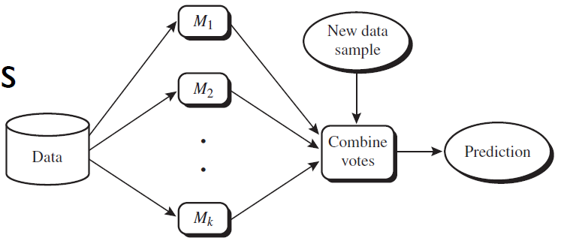
Ensemble Methods
Use a combination of multiple models to increase accuracy
Popular ensemble methods
bagging: equal-weight votes
boosting: weighted votes
Ravi Starzl, PhD - Data Mining Fall 2023
Notes:
Ensemble methods capitalize on the strength of the "crowd" to improve prediction accuracy. They recognize that no single model is perfect and that different models capture different patterns or nuances in the data. By combining these models, we're not just hoping for better accuracy, but we're also aiming for a more consistent and reliable prediction system.
Key Takeaways:
1. Collective Wisdom: Just as a panel of experts might provide a more comprehensive view on a subject than a single individual, ensemble methods combine the decisions of multiple models to arrive at a final prediction.
2. Diverse Input: Diversity is the key. The ensemble works best when its constituent models are different, which ensures that different kinds of errors made by one model might be caught by another.
3. Bagging:
- Equal Voting: In bagging, every model gets an equal say in the final decision. The strategy is to reduce variance by training them on different subsets of the data.
- Bootstrap Aggregating: It involves taking multiple random sub-samples (with replacement) from the dataset and training a model on each. These models then "vote" to produce the final prediction.
- Example: Random Forests is a popular algorithm that employs bagging with decision trees. It not only samples data points but also features, adding another layer of diversity.
4. Boosting:
- Weighted Voting:
Boosting is more adaptive. Models that perform well get a higher weight in the final decision, while those that don't get lower weights.
- Adaptive Training:
Boosting starts with a base model and then, in subsequent iterations, focuses on the instances that were wrongly predicted, attempting to correct previous mistakes.
- Example: AdaBoost (Adaptive Boosting) is a popular boosting algorithm. It adjusts the weights of instances based on the errors of the current classifier, ensuring that subsequent classifiers focus more on challenging instances.
5. Visual Representation: The visualization typically depicts individual models as contributors to the final decision. The decision of each model, often visualized as arrows or vectors, culminates in a combined decision that represents the consensus of all the models.
6. Sum Greater than Parts: Ensemble methods embody the philosophy that a collective decision, informed by multiple perspectives (or models), is often better than a decision made in isolation. The ensemble approach offsets individual model biases, errors, and limitations, leading to a more generalized and robust model.

Slide 29

Bagging: Bootstrap Aggregation
Analogy: diagnosis by multiple doctors
multiple doctors’ majority vote
Training: given a data set D of d tuples
training set Di: d tuples sampled randomly with replacement (i.e., bootstrap)
classifier Mi is learned for Di
Classification: majority vote
Prediction: average of multiple predictions
Ravi Starzl, PhD - Data Mining Fall 2023
Notes:
1. Bootstrap Sampling: The foundational idea behind bagging. It involves creating multiple training datasets by randomly sampling with replacement from the original dataset. This replacement ensures that each sample is independent and identically distributed.
2. Diversity in Classifiers: Since each training set is distinct due to bootstrap sampling, the models trained on them are inherently diverse. This diversity ensures that errors made by one classifier might be caught by another, leading to a more robust ensemble.
3. Democracy in Action: In classification problems, each model in the ensemble gets a vote. The class that receives the most votes is chosen as the final prediction. This majority voting system stabilizes the prediction process, reducing the impact of individual model errors.
4. Averaging for Regression: For regression tasks, bagging doesn't rely on voting. Instead, it takes the average of predictions from all models. This averaging serves to smoothen out the predictions, potentially offsetting the overestimations of some models with the underestimations of others.
5. Benefits of Bagging:
- Reduction in Variance: By averaging out the predictions of multiple models, bagging reduces the chances of erratic predictions based on specific quirks in the training data.
- Mitigates Overfitting: Since each model sees only a subset of the data (and some data points multiple times), the chance of any single model overfitting to the entire dataset is diminished.
- Parallelism: One of the practical benefits of bagging is that since each model is trained independently, the training process is inherently parallelizable. This means bagging can be efficiently scaled with computational resources.
6. Real-world Analogy: The doctors' analogy is apt. Just as a patient might seek multiple opinions to get a more reliable diagnosis, bagging seeks opinions from multiple models to arrive at a more stable and reliable prediction.
7. Widely Used with Decision Trees: While bagging can be used with various base models, it's most commonly associated with decision trees. Trees are known to have high variance (they can change a lot based on small changes in the input data). Bagging helps stabilize them, leading to the popular ensemble method known as the Random Forest.

Slide 30

Boosting
Analogy: diagnosis by multiple doctors
weighted by previous diagnosis accuracy
Weights are assigned to each training tuple
A series of k classifiers is iteratively learned
After classifier Mi is learned, adjust weights so Mi+1 pays more attention to tuples that were misclassified by Mi
M* combines the votes of all k classifiers, weighted by individual accuracy
Ravi Starzl, PhD - Data Mining Fall 2023
Notes:
1. Sequential Learning: Unlike Bagging, where models are trained independently, Boosting builds models iteratively. Each new model is influenced by the performance of those built before it.
2. Weighted Learning: The cornerstone of Boosting is the way it assigns and adjusts weights to training instances. Misclassified instances gain importance in subsequent rounds, nudging the algorithm to pay more attention to them.
3. Voting with a Twist: When making predictions, each classifier in the ensemble gets a say, but their votes aren't equal. Classifiers that have demonstrated better accuracy on the weighted training set have more influence over the final outcome.
4. Doctors' Analogy: It's like having a group of doctors sequentially diagnosing a tricky patient. If one doctor misdiagnoses, the next doctor is briefed to be especially attentive to the symptoms the previous one missed. Furthermore, when deciding on a treatment, the opinions of doctors who have been more accurate in the past weigh heavier in the decision-making process.
5. Weak Learners to Strong Learner: One of the beauties of Boosting is its ability to turn weak learners—models that perform just slightly better than random guessing—into a strong learner that has high accuracy. By repeatedly correcting mistakes of previous models, Boosting can achieve impressive results.
6. Potential Issues: While Boosting can lead to exceptional performance, it's not without its pitfalls. It can be more susceptible to overfitting, especially with noisy data. This is because the algorithm is so focused on correcting its mistakes that it might start to fit to the noise. Care must be taken when using Boosting, and it's essential to monitor for signs of overfitting.
7. Variants and Popular Algorithms: While the general concept of Boosting is consistent, various algorithms implement it differently. AdaBoost, or Adaptive Boosting, is one of the most popular and foundational Boosting algorithms. Later, other algorithms like Gradient Boosting and XGBoost have built upon and refined the basic Boosting technique, often delivering even better performance and offering more tunable parameters.

Slide 31

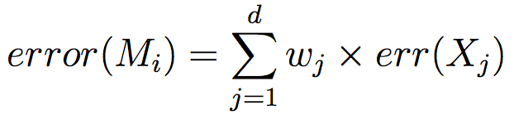
Adaboost (1)
D: (X1, y1), (X2, y2), ..., (Xd, yd)
Initial weight of each tuple: 1/d
Round i (i=1, ..., k)
Di: sample d tuples w/ replacement from D
Pr(choose tuplej) based on tuplej’s weight
Learn Mi from Di, compute its error rate
Ravi Starzl, PhD - Data Mining Fall 2023
Notes:
1. Adaptive Weighting: The core of AdaBoost is its ability to adaptively adjust the weights of instances based on the errors of the classifiers. Misclassified instances gain more importance in subsequent rounds, prompting the algorithm to focus on them.
2. Equal Starting Weights: Initially, each instance in the dataset has an equal weight, ensuring all have an equal chance of being selected in the first round.
3. Bootstrap Sampling with Weights: AdaBoost samples instances from the dataset to create a new dataset for each round. The probability of an instance being selected is directly related to its weight. More significant weights increase the chances of an instance being chosen.
4. Error Computation: The error of a classifier is the sum of the weights of the instances it misclassifies. This error computation aligns with AdaBoost's philosophy of emphasizing mistakes, as misclassifying a high-weight instance incurs a larger error.
5. Classifier Combination: After all rounds are completed, AdaBoost doesn't simply take a majority vote. Instead, classifiers' decisions are weighted based on their accuracy. More accurate classifiers have a bigger say in the final decision.
6. Illustrative Example: The example of the red orange fruit perfectly captures the spirit of AdaBoost. By emphasizing and repeatedly resampling misclassified instances, AdaBoost pushes classifiers to adapt and correct their mistakes. This ensures that even outliers or challenging instances, which might be ignored or misclassified by a single model, are duly recognized and handled by the ensemble.
7. Iterative Learning: AdaBoost's iterative learning process ensures that with each round, the classifier is better equipped to handle the nuances and intricacies of the data.
8. Resulting Model: The final AdaBoost model is a collective effort of all classifiers. Each contributes its understanding, and their combined wisdom offers a more nuanced and accurate classification than any individual classifier.

Slide 32
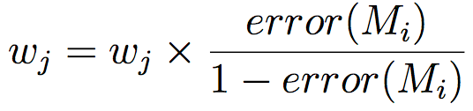
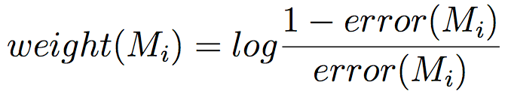
Adaboost (2)
Round i (continued)
Reduce weights of correctly classified tuples
Normalize tuple weights so sum is 1.0
e.g., (0.1, 0.3, 0.1) => (0.2, 0.6, 0.2)
Classification: weighted votes of k classifiers
Ravi Starzl, PhD - Data Mining Fall 2023
Notes:
AdaBoost, which stands for Adaptive Boosting, is an ensemble method due to its adaptive learning approach. It focuses on training instances that have been previously misclassified, ensuring that successive classifiers correct earlier mistakes.
1. Emphasis on Errors: AdaBoost uniquely adjusts its focus based on the performance of the previous classifiers. Instances that were misclassified in earlier rounds are given more importance in subsequent rounds, prompting the next classifiers to prioritize them.
2. Adjusting Instance Importance: After each round of classification, the importance (or weight) of each instance in the dataset is recalibrated. Instances that were correctly classified have their importance reduced, while those that were misclassified see an increase in their importance. This adjustment ensures that the more challenging instances get more attention in the subsequent rounds.
3. Classifier Importance: Each classifier in the ensemble is assigned an importance score based on its performance. Classifiers that perform well (i.e., have a low error rate) are given more significance in the final decision, while those that perform poorly might even be disregarded.
4. Illustrative Example: Imagine we have three classifiers. The first classifier does an excellent job and is given a high importance score. The second one performs decently and is given a moderate score. The third classifier, which merely guesses the outcome, is not given any importance in the final decision-making.
5. Final Decision Making: For a new data instance, each classifier in the ensemble gives its prediction. However, these predictions aren't treated equally. They are combined based on each classifier's importance score, and the final outcome is the one that gets the highest combined score.
6. Strength Through Collaboration: AdaBoost showcases the power of collective decision-making. By merging the strengths of multiple models, it offers a comprehensive approach that often outperforms any individual model.
7. Cautionary Note: While AdaBoost's adaptiveness is its main advantage, it can sometimes be a double-edged sword. If there's noise or outliers in the data, AdaBoost might overemphasize them, leading to overfitting. It's essential to monitor its performance and, if necessary, use it in conjunction with other techniques.

Slide 33

Ensemble Methods: Accuracy
Bagging
often significantly better than single classifier
noise: not considerably worse, more robust
prediction: proved improved accuracy
Boosting
generally higher accuracy than bagging
may overfit the model to misclassified data
Ravi Starzl, PhD - Data Mining Fall 2023
Notes:
Bagging and Boosting are both ensemble methods in machine learning, but they approach the task of classification from distinct angles, each with its strengths and challenges.
Bagging:
Concept: Bagging (Bootstrap Aggregating) involves creating multiple subsets of the original dataset by sampling with replacement. A model is then trained on each subset, and their predictions are aggregated.
Goal:The primary goal is to reduce variance and overfitting, resulting in a more stable and consistent model.
Advantages: Bagging is notably robust to noise in the data. By averaging out the results, noise and outliers have less influence on the final prediction.
Illustration: Consider predicting loan defaults. A single decision tree might be too sensitive to the specifics of the training data. But with Bagging, you might train 100 trees on different subsets. For a new prediction, each tree "votes", and the majority decision is chosen. This process dilutes the quirks of individual trees, giving a more generalized and robust decision.
Boosting:
Concept: Boosting iteratively trains models, with each new model focusing on the errors or misclassifications of the previous ones.
Goal: The aim is to boost weak models into stronger ones, enhancing accuracy.
Challenges: Boosting can sometimes overfit to the data, especially if there are outliers or noise. It might give too much emphasis to these challenging instances, affecting its generalization capability on new data.
Illustration: Think of medical specialists diagnosing a disease. The first specialist might miss some symptoms. The next specialist focuses on those missed symptoms and might catch a few more but still miss others. Subsequent specialists then focus on the remaining symptoms. Together, they're more likely to correctly diagnose the patient than any one of them alone.
Summary:
Bagging is like a committee where every member has an equal say. It banks on the wisdom of the crowd, hoping individual errors cancel out, resulting in a better collective decision.
Boosting is more of a relay race, where each runner (or model) builds on the performance of the previous one, trying to correct its errors.

Slide 34
Bayesian classification
Bayes' theorem
Rule based classification
If-Then rules
Rule Assessment and quality measures
Model evaluation and selection
Accuracy & error measures
Confusion matrix
T-test
Improve classification and accuracy
Bagging
Boosting
Summary
Ravi Starzl, PhD - Data Mining Fall 2023

Slide 35
Thank you
A special thank you to Qin Lv for her slides, on which this lecture is based
Ravi Starzl, PhD - Data Mining Fall 2023

